Slide 1

Social Media Platform For College Students
Welcome to our presentation about College Social, a cutting-edge platform designed to foster community and connection among students.
T. Hemanth Kumar (192211935)
S. Nithish (192210322)

Slide 2
Problem Statement
1. Lack of a Dedicated Space for College Students:
Existing social media platforms aren’t tailored to college students' academic, social, and career needs.
2. Difficulty in Academic Collaboration:
Students struggle to collaborate efficiently on projects and share study resources on general platforms.
3. Disconnected Student Communities:
Students find it hard to connect with peers in clubs, societies, or groups based on shared interests.
4. Event Management and Participation:
Organizing and joining campus events is scattered across different channels, making it hard to track.
5. Lack of Career and Internship Opportunities:
There is no central platform for students to access job, internship, and career resources.

Slide 3

AIM
Connecting students
Building community
Creating connections
College Social aims to create a dedicated space where students can connect with peers.
Our platform fosters a sense of belonging and provides opportunities for shared experiences.
College Social encourages meaningful interactions and fosters lasting friendships.

Slide 4

Abstract
- Designed specifically for college students to address academic, social, and career needs.
- Provides tools for easy sharing of resources, group projects, and study discussions.
- Connects students with clubs, societies, and campus events, fostering a stronger sense of community.
- Serves as a hub for job postings, internships, and career resources.
- Combines communication channels for students, professors, and staff into one platform.
- Allows students to personalize their feed based on academic, social, and career interests.
- Simplifies event creation, promotion, and participation within the student community.

Slide 5

Introduction
Social Isolation
Tech Integration
Traditional methods of socializing on campus are often ineffective, leading to loneliness and disconnect.
College Social leverages technology to create a dynamic and interactive environment for students.
Empowering Connection
Our platform aims to bridge the gap between online and offline interactions, fostering a sense of belonging.

Slide 6
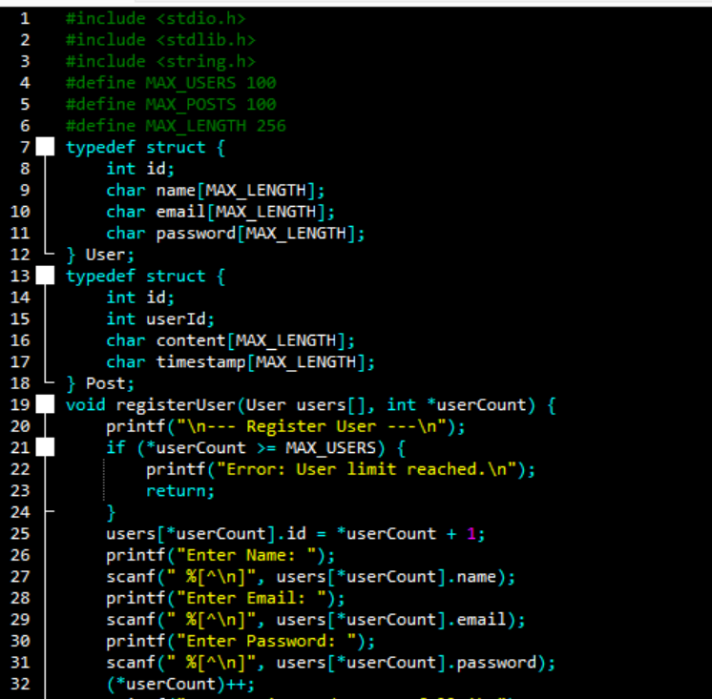
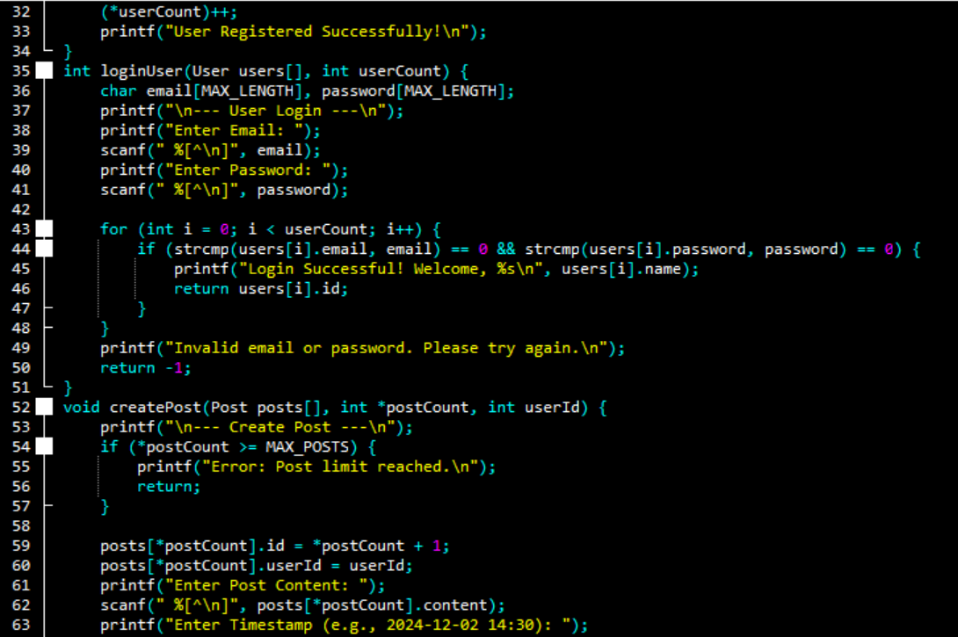
Code & Implementation

Slide 7
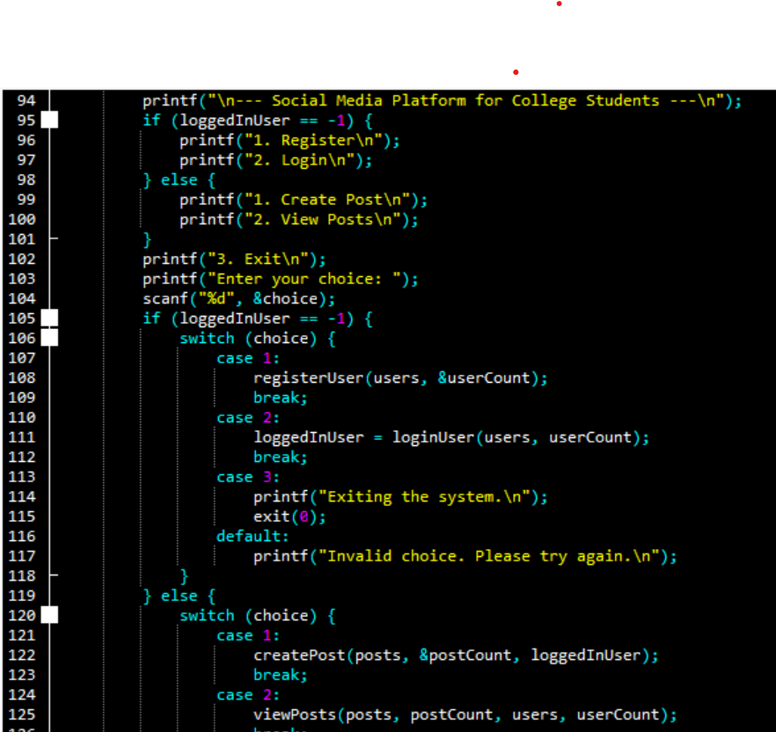
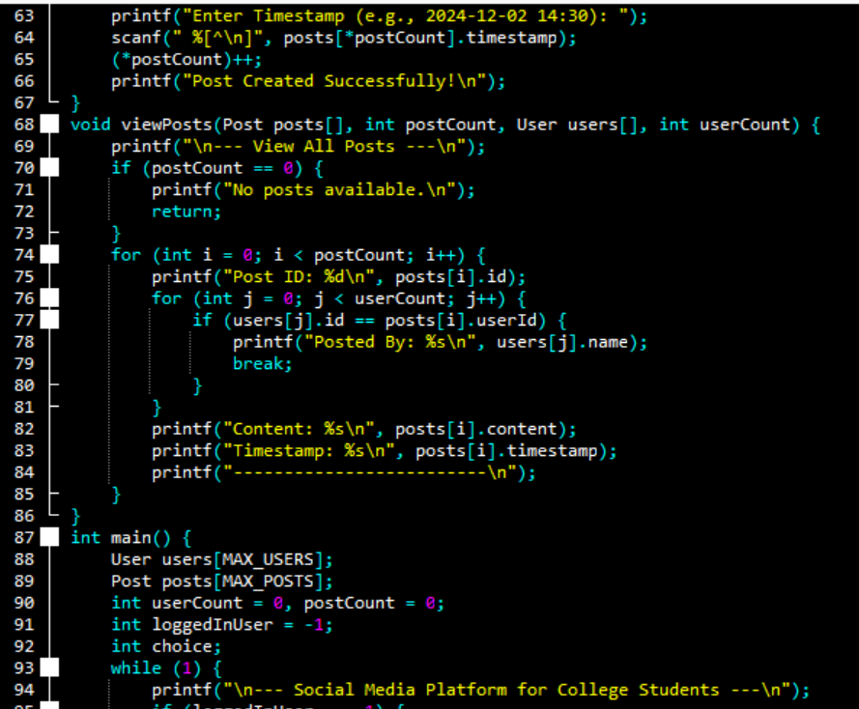
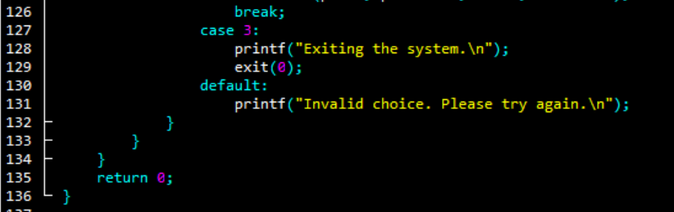

Slide 8
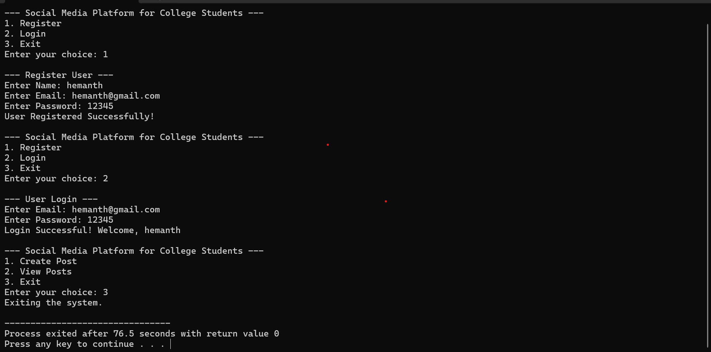
Output

Slide 9
Engineering Standards
Software Development Standards
- ISO/IEC 12207: Guides the SDLC process, ensuring organized planning, development, testing, deployment, and maintenance.
- IEEE 829: Specifies testing documentation to ensure platform functionality, security, and usability.
- ISO/IEC 25010: Focuses on functionality, reliability, usability, performance, security, maintainability, and portability for high-quality software.
- IEEE 730: Stresses reviews, audits, and evaluations for continuous quality assurance.
2. C Language Standards (if applicable)
- ISO/IEC 9899:2011 (C11): Ensures secure operations through features like multithreading and bounds-checking.
- ISO/IEC 9899:2023 (C23): Improves performance and compatibility with updated features.
3. Data Security and Privacy Standards
- ISO/IEC 27001: Sets requirements for a robust security management system to protect user data.
- GDPR and CCPA: Ensures compliance with global data privacy laws.
- OWASP: Follows best practices to protect against security threats like SQL injection and XSS.
4. Usability and Accessibility Standards
- ISO 9241: Focuses on creating an intuitive, user-friendly interface.
- WCAG: Ensures platform accessibility for users with disabilities.
- ISO/IEC 25062: Guides usability testing and enhances user experience.
5. System Performance Standards
- ISO/IEC 14764: Ensures platform reliability through ongoing maintenance.
- ISO/IEC 9126: Sets performance benchmarks, including response times and resource optimization.

Slide 10



Future Scope
Expanding Features
1
Integration of additional features for group projects and academic resources.
Community Building
2
Enhancing the platform's capabilities to support diverse student groups and initiatives.
Partnering with Universities
3
Collaborating with institutions to seamlessly integrate College Social into campus life.

Slide 11

Conclusion
The social media platform for college students is designed to address their unique academic, social, and career needs by providing tools for collaboration, campus engagement, and career development.
It fosters a stronger sense of community, supports student well-being, and ensures privacy and security.
With a focus on user-friendly design, the platform is scalable and adaptable to meet evolving student needs, offering a safe and seamless experience that grows with technological advancements.

